Slide 1

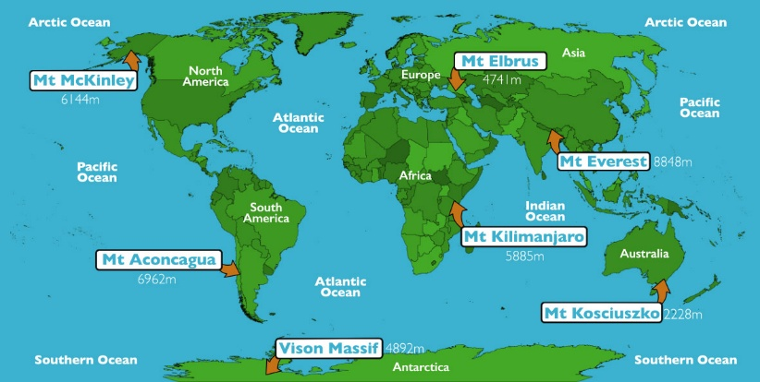
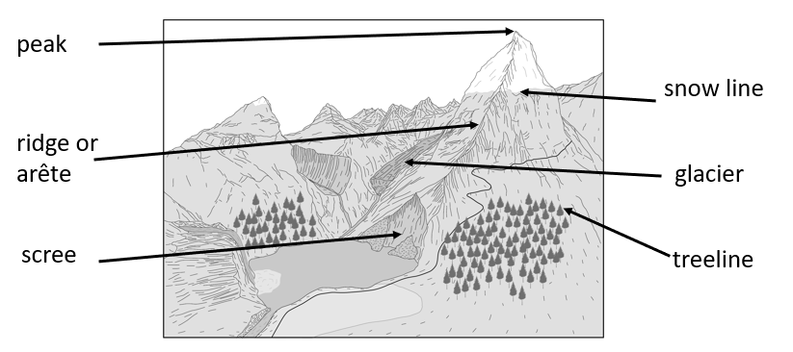
Greenfields Community School– Knowledge Organiser
Geography | I wonder why we have mountains. | Year 5 | Autumn 2
Five Fabulous Facts about Planet Earth.
I know the Earth is made up of four different layers (inner core, outer core, mantel and crust). I know the crust is split into tectonic plates.
I know mountains are formed when two plates move closer to each other or converge.
I know that land must be above 3000m for it to be classed as a mountain.
I know the world’s highest peak is Mount Everest.
I know one of the highest points in the UK is Snowdon, lots of people visit there.
Highest peaks
Vocabulary
Mountain range – a group of mountains Base – the bottom of a mountain peak – the highest point of a mountain Tectonic plates – the pieces of earth’s crust Sea level – the average height of the surface of the sea used to measure how high mountains are Structure – the way something is built or arranged Crust – the thin, solid outer layer of the earth
Features of a mountain

