Slide 1

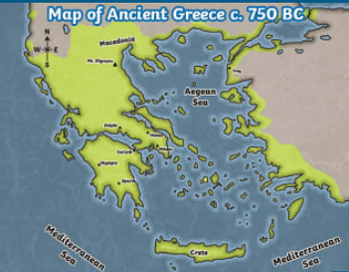
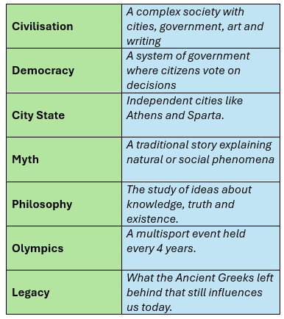
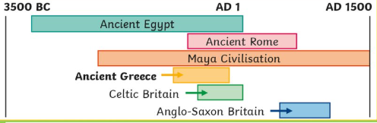
Greenfields Community School– Knowledge Organiser
History | I wonder what the Ancient Greeks did for us, | Year 6 | Autumn 1
Five Fabulous Facts about sustainability
I know that the ‘Golden Age’ of Ancient Greece was the 5th and 6th Century BC and most of what we know comes from archaeological evidence (pots and Ancient ruins) and written evidence (myths and legends)
I know that Ancient Greece was made up of city states which often fought each other. Athens and Sparta are examples of these.
I know that a democracy is a form of government where citizens get to participate in decisions. I know Athens is where the first known democracy began.
I know the Olympics originated in Ancient Greece. This was a religious festival in honour of the god Zeus.
I know some of the ways Ancient Greeks have influenced our lives today, such as: democracy, government, philosophy, art and architecture, language and literature.
Map of Ancient Greece
Vocabulary
Timeline

Slide 2


