Slide 1

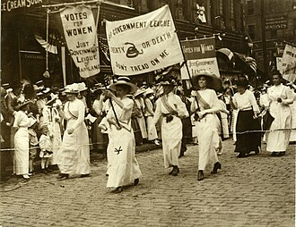
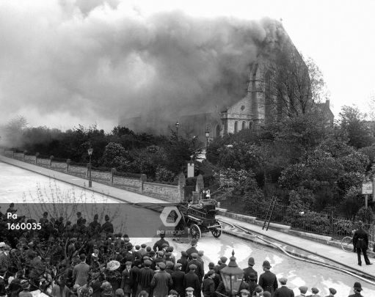
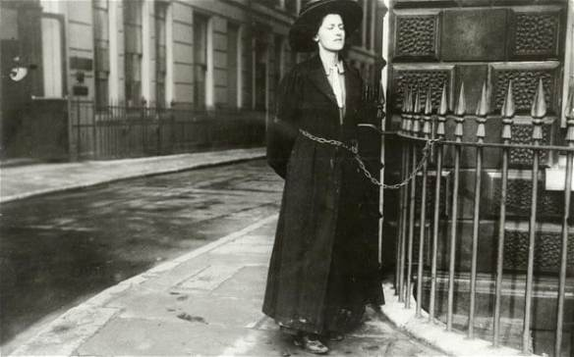
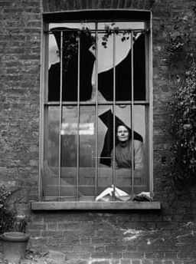
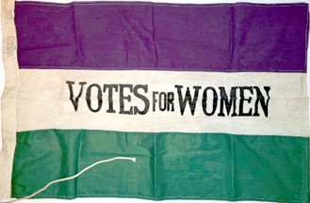
Greenfields Community School– Knowledge Organiser
History | I wonder how the Suffragettes impacted the life of Women. | Year 5 | Summer 1
Five Facts about the Industrial Revolution.
I know the Suffragettes were a group of women who protested and fought for women to have the right to vote.
I know the Suffragettes marched in protest, gave speeches, wrote letters to leaders and sometimes broke the law to get attention.
I know many people were against women getting the vote as they thought women were too emotional, they didn’t know enough and a woman’s place is in the home.
I know a lot of people were for women having the vote as they believed women should have the same rights as men and they made big contributions to the country, particularly during WWI.
I know Helen Kirkpatrick Watts was a Suffragette from Nottingham. She had a hearing impairment.
Different ways the Suffragettes protested.
Purple, white and green
The Suffragettes wore purple, white and green which stood for dignity, purity and hope.
Vocabulary
Rights – things that people are allowed to do or have such as voting or going to school. Protest – a series of actions (like speeches or marching) to persuade people to support a cause. Parliament – The place where laws are made in the UK. Equality – Everyone being treated the same and having the same rights.

