Slide 1

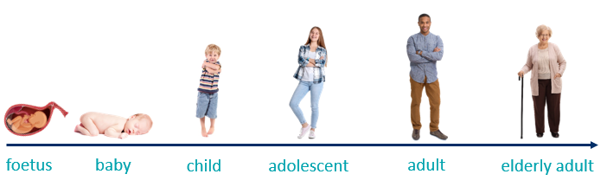
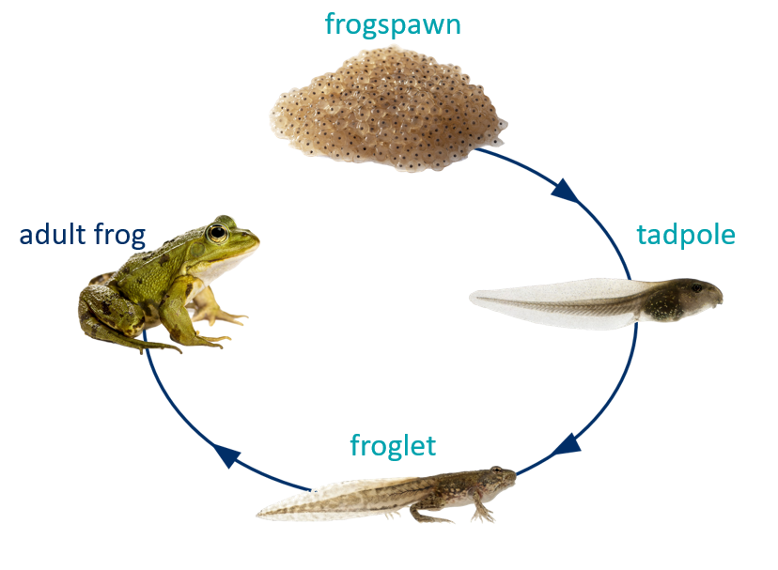
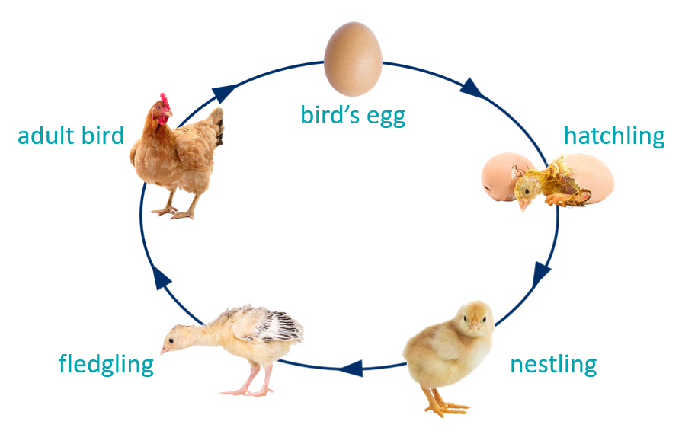
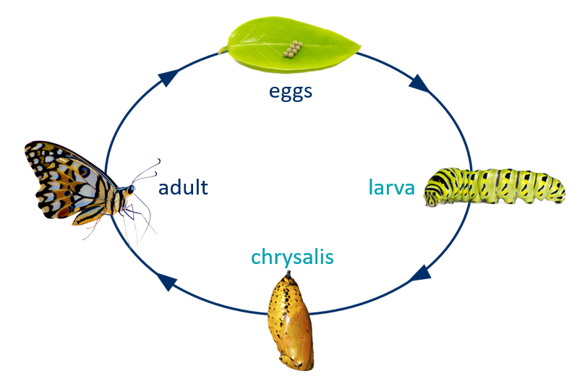
Greenfields Community School– Knowledge Organiser
Science | Biology: Life Cycle | Year 5 | Summer 1
Five Fabulous Facts about life cycles.
I know each animal has a life cycle. Humans have six stages in their life cycle – foetus, baby, child, adolescence, adult, elderly adult.
I know milestones are significant points in a human’s life. Everyone reaches milestones at different ages.
I know physical changes that happen during adolescence is called puberty.
I know larger mammal have a longer gestational period.
I know that as adults age their bones become weaker and more fragile.
Life Cycle of a human
Vocabulary
Gestational period – the amount of time a foetus develops in it’s mother’s womb. Milestones – significant events in a human’s life. Lifespan – period of time an animal is alive. Life cycle – a series of stages a living thing goes through in it’s life. Mammal – an animal with a spine, hair or fur and give birth to live young. Monotreme - a mammal that lays eggs such as a platypus Metamorphosis - the young form of an animal changes into the adult form. Insect - a small animal that has three body sections, six legs and antennae.
Life cycles

