Slide 1

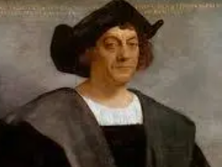
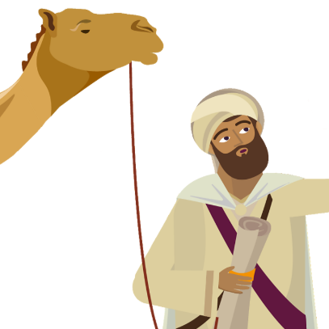
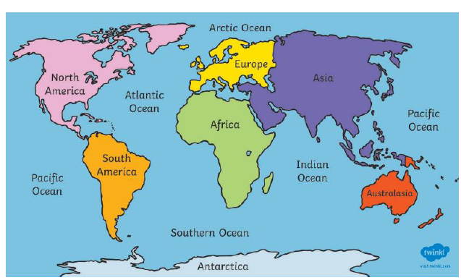
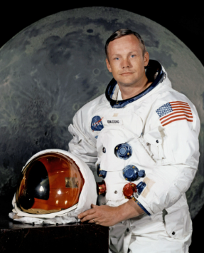
Greenfields Community School– Knowledge Organiser
History | Famous explorers | Year 2 | Summer 1
I wonder what explorers from the past have achieved?
Christopher Columbus (1451 - 1506)
Christopher Columbus wanted to find a new route to India and China but instead he arrived in Central America. There were already native Americans living there. He used ships to sail and explore. Columbus bought lots of things back from his voyage including gold and exotic fruit
Vocabulary
Empire
Explorer,
voyage,
continent, Americas, compass, merchant, navigator,
Hajj,
Emperor, Pilgrimage,
Ibn Battuta 1304- 1369 approximately
Ibn Battuta was a famous explorer from Morrocco born 700 years ago. when he was 21 he went on a Pilgrimage (hajj) to Mecca. He mostly travelled by camel.
Neil Armstrong 1930-2012
Neil Armstrong was the first person to step foot on the moon in 1969 Neil Armstrong was a pilot before he became an astronaut. The ‘space race’ was between the USA and Russia and that both wanted to be the first to put a man on the moon.

