Slide 1

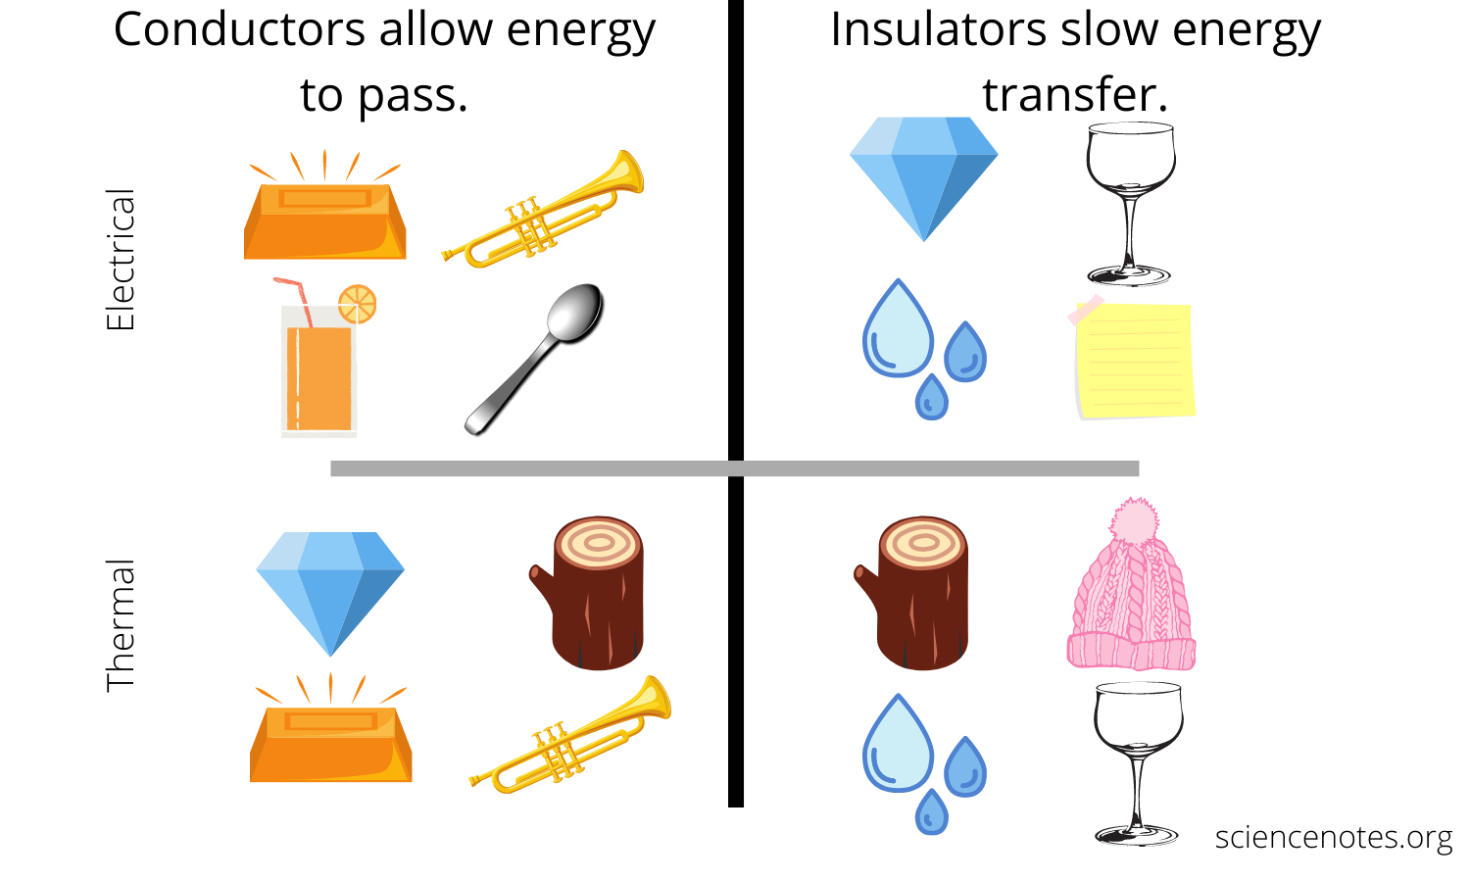
Greenfields Community School– Knowledge Organiser
Science | Chemistry: Properties of Materials | Year 5 | Spring 1
Five Fabulous Facts about the properties of materials.
We can complete a scratch test to measure an objects hardness. The harder it is to scratch or alter an object, the harder it is.
Each end of a magnet is called a pole (north or south). If opposite poles of a magnet come into contact, it will attract. If the same poles of a magnet come into contact, it will repel.
Magnet attract magnetic objects. Magnets repel non-magnetic objects.
Electric conductors allow electricity to flow easily. Electric insulators do not.
A thermal insulator keeps heat contained.
Variables
Independent variable – the thing that is changed Dependent variable – what is measured Control variable – what is kept the same
Vocabulary
Hardness- a measure of how resistant a solid is to a change of shape Magnetism - a non-contact force created by a magnet Opaque - an object or material that does not allow any light to pass through it Transparent - an object or material that allows light to pass through it Translucent - an object or material that allows some light pass through it Electrical conductor - material that allows electricity to flow through it easily Electrical insulator - material that does not allow electricity to flow through it easily
Conductors and insulators

