Slide 1

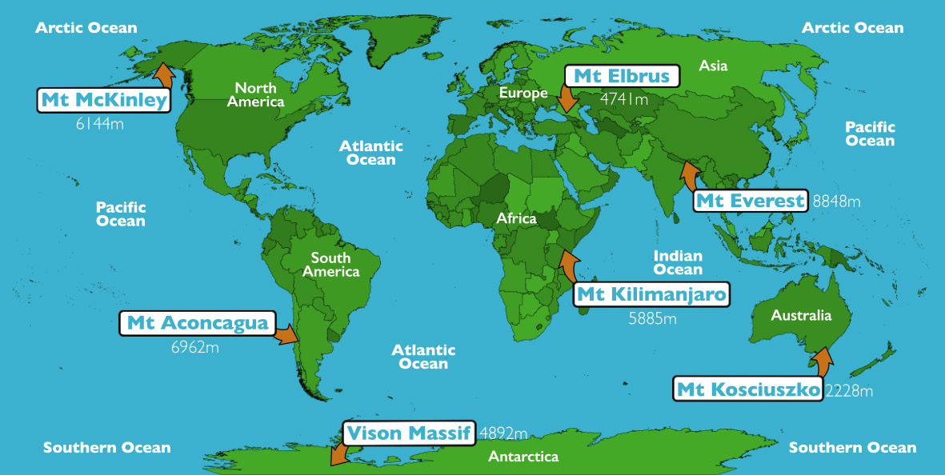
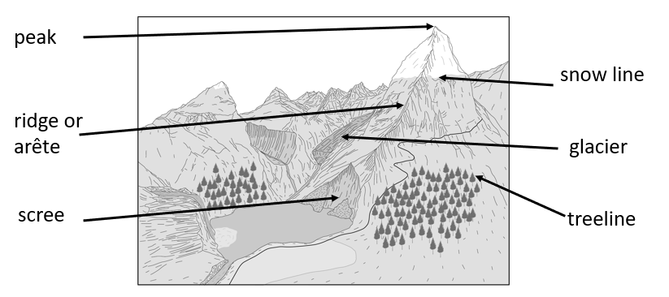
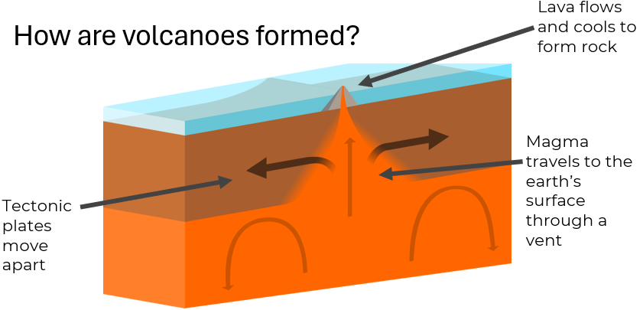
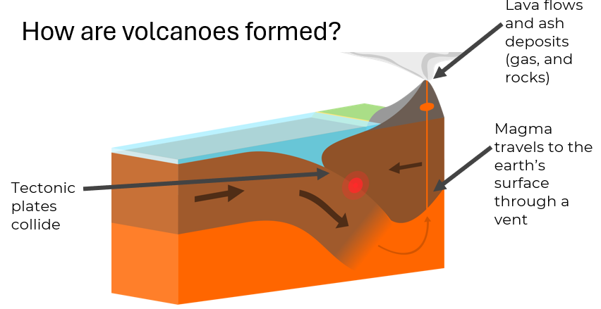
Greenfields Community School– Knowledge Organiser
Geography | I wonder why there are mountains, earthquakes and volcanos. | Year 5 | Spring 2
Five Fabulous Facts about Planet Earth.
I know the Earth is made up of four different layers (inner core, outer core, mantel and crust). I know the crust is split into tectonic plates.
I know mountains are formed when two plates move closer to each other or converge.
I know that land must be above 3000m for it to be classed as a mountain. I know the world’s highest peak is Mount Everest.
I know a volcanic eruption happens because pressure builds up beneath the surface until magma explodes to the surface.
I know an earthquake is a vibration of the earth’s crust. I know earthquakes mainly occur along tectonic plate boundaries.
Highest peaks
Vocabulary
Mountain range – a group of mountains Summit – the highest part of a mountain Magma – extremely hot molten rock found beneath the earth’s surface Tectonic plates – the pieces of earth’s crust Extinct volcano – no longer a threat
Features of a mountain
How are volcanoes formed?

