Slide 1

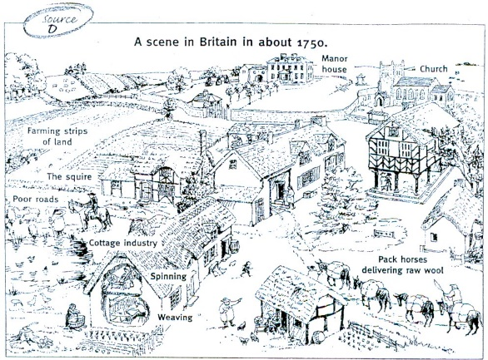
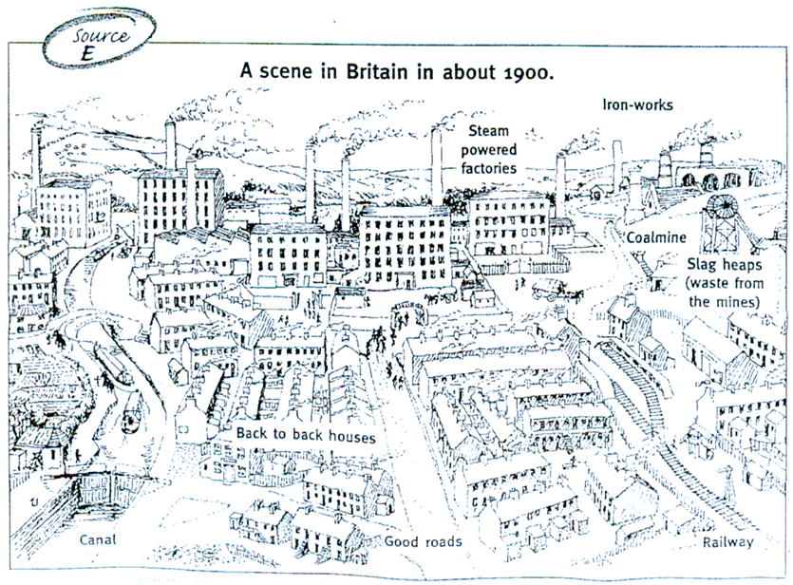
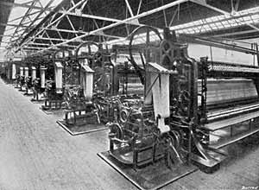
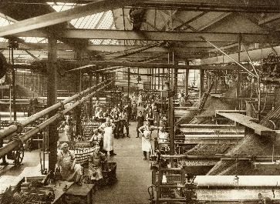
Greenfields Community School– Knowledge Organiser
History | I wonder how Nottingham was impacted by the Industrial Revolution. | Year 5 | Spring 1
Five Facts about the Industrial Revolution.
I know that the Industrial Revolution took place between 1750 and 1900 during the expansion of the British Empire.
I know that they key types of industry in Britain during the Industrial Revolution were textiles, coal mining, iron and steel and railways.
I know that the Lace Market in Nottingham became the heart of the lace industry, where many factories were built.
I know that the Luddites were a group of textile workers who protested against the introduction of knitting frames.
I know that many children worked during the industrial revolution to support their families.
Before and after the industrial revolution.
Advantages and disadvantages
Advantages Technological advances Increase in Nottingham economy because of the lace industry. Disadvantages Condition in coal mines and factories were dangerous. A rise in the population means that more house was needed, due to the poor condition of the houses, living conditions worsened.
Vocabulary
Industrial – A group of manufacturers/ business that produce goods.
Revolution – Bringing about a new change / rebellion.
Chronology – the arrangement of events or dates in order.
Working class – a group of people in society who do not own much property, who have low social status and who do jobs which involve using physical skills.
Child labour – the employment of children in an industry or business.
Population – the number of people living in a certain place.
Luddites – a group of textile workers the protested against the introduction of knitting frames.

