Slide 1

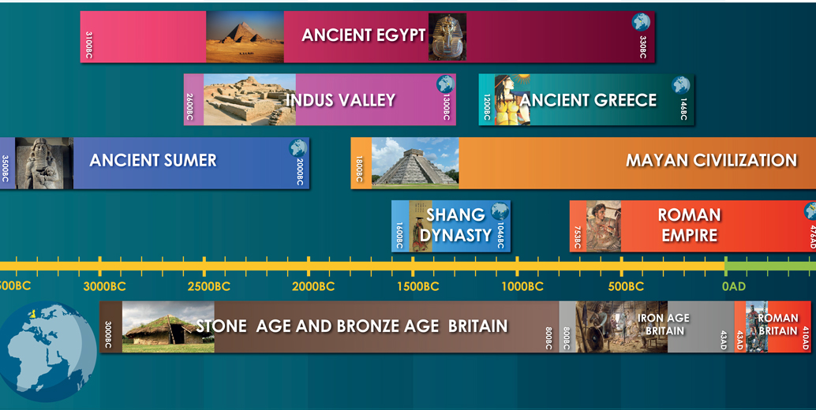
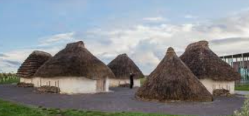
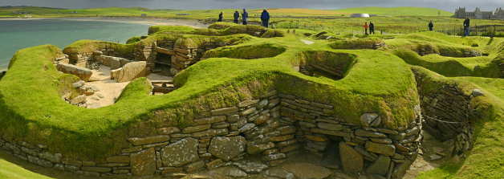
Greenfields Community School– Knowledge Organiser
History focus | I wonder how we can know about life in the Stone Age through to the Iron Age. | Year 3 | Spring 1
Five Facts about the Ancient Greeks.
I know what the prehistoric period was and how life changed during this time.
I know how different life was in the Stone Age when man started to farm.
I know how homes changed during the prehistoric period.
I know about life in the Stone Age from a study of Skara Brae.
I know how the discovery of metals changed life in Britain.
World History Timeline
Neolithic Houses
Vocabulary
Palaeolithic | The Palaeolithic period was the earliest part of the Stone Age, when people were hunter-gatherers, lived nomadic lives, and used simple stone tools.
Mesolithic | It was a time when people still hunted and gathered food but began to make better tools and stay in one place for longer.
Neolithic | It was a time when people started farming, kept animals, and built homes so they could live in one place..
Archaeology, | Archaeology is the study of things that people made, used, and left behind.
Artefact | An artefact is a man-made object, such as pieces of art or tools, that is of particular cultural, historical or archaeological interest.
Skara Brae

