Slide 1

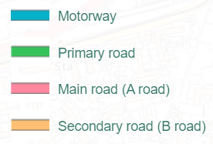
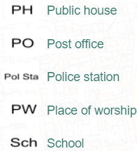




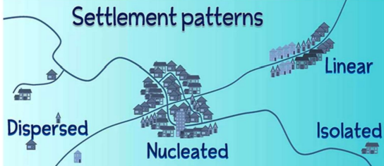
Greenfields Community School– Knowledge Organiser
Geography Focus | I wonder how my local area compares to other areas around Nottingham | Year 3 | Spring 2
Five Fabulous Facts about settlements in Nottingham.
I can describe where people live in the UK. I can identify features I might find in different places.
I can explore an OS map of my local area
I can create a simple map of my local area. I can include a key to show what symbols mean
I can describe how my local area has changed over time.
I can explain why people choose to live in certain places.
OS Map key
Vocabulary
City Town Suburb Village Hamlet Local post office war memorial Shops Community Settlement Migration land use Population Development Residential Industrial Commercial recreational

