Slide 1



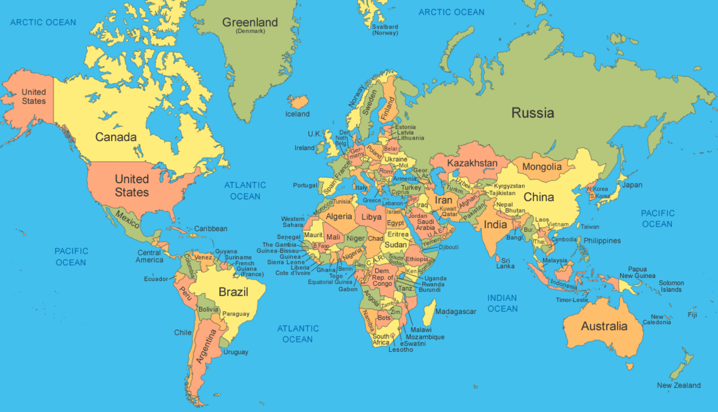
Greenfields Community School– Knowledge Organiser
Geography | Terrific Toys | Year 2 | Spring 2
I wonder how living in London is different to living in Delhi?
Fabulous Facts
. Delhi is in India . India is in Asia . London Is in England .England is in Europe . Delhi is 4000 miles away from London and it would take 10 hours to get there. . Delhi has a warmer climate than London because it is closer to the equator.
Key Vocabulary City – A place where lots of people live and work Capital city – The most important city in a country Climate – What the weather is usually like Landmark – A famous building or place Equator -The equator is an imaginary line circling Earth at latitude, located exactly halfway between the North and South Poles.

