Slide 1


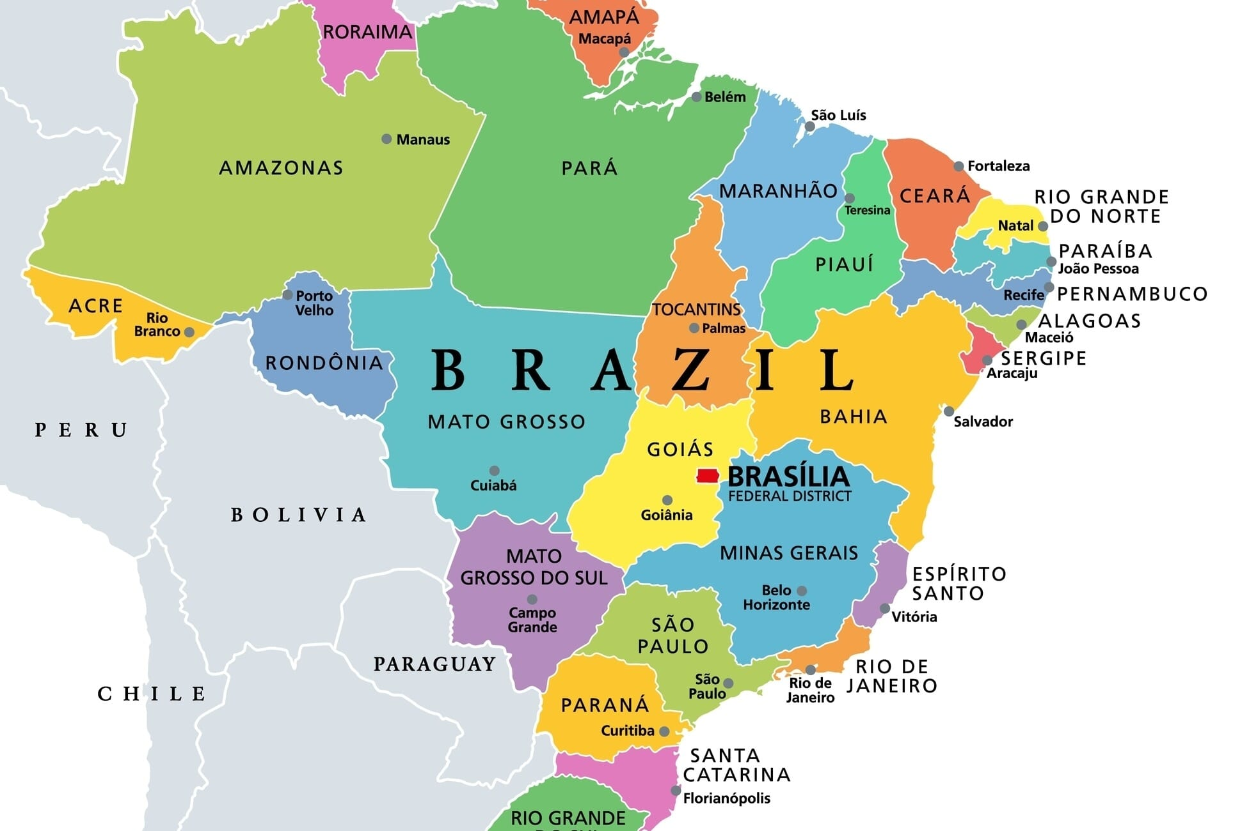





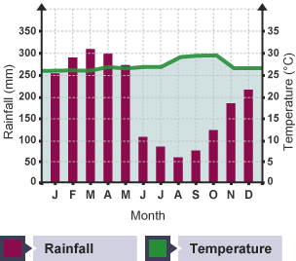


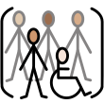

Greenfields Community School– Knowledge Organiser
Geography focus | I wonder what life is like in Brazil. | Year 4 | Spring 2
Five Facts about the Brazil.
I know that Brazil is in South America and spans across the equator.
I know Brazil is a multi-racial nation made up of indigenous, African and European people.
I know some key physical features in Brazil are The Amazon Rainforest Basin, The Amazon river, coastline and wetlands.
I know the climate of Brazil is tropical with hot humid conditions all year round with high rainfall.
I know that most of the population of Brazil live in urban areas.
Map of Brazil
Key Vocabulary
Equator - An invisible line that goes around the middle of the Earth, like a belt.
South America - A large continent on Earth made up of many countries, rainforests, mountains, and animals.
Border - An imaginary line that shows where one country ends and another begins.
Rainforest - A thick, green forest that gets lots of rain and has many plants, trees, and animals.
Wetlands - Areas of land that are very wet and often covered in water, like marshes or swamps.
Indigenous - The first people who lived in a place before anyone else arrived.
Catholicism - A religion followed by many people around the world who believe in God and follow the teachings of the Catholic Church.
Tropical - Describes a place that is warm, humid, and close to the Equator.
Population - The number of people who live in a place.
Poverty - When people do not have enough money to buy the things they need, like food, clothes, or a home.
Climate graph - Manaus, Brazil

