Slide 1

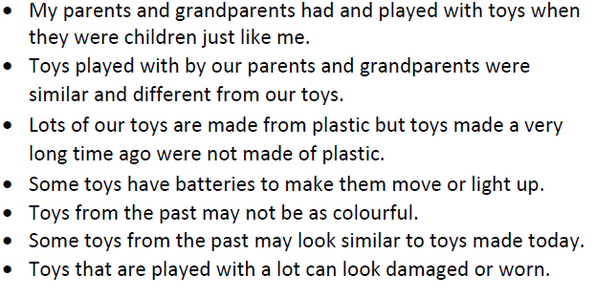
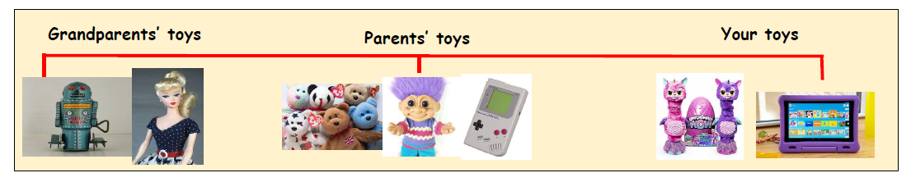
Greenfields Community School– Knowledge Organiser
History | Terrific Toys | Year 1 and 2 | Spring 1
I wonder what people played with before tablets?
Fabulous Facts
A long time ago Toy Timeline Now
Key Vocabulary
Past, long ago, present, now, today, same, different, compare, before, after, 20th century, 21st century, grandparent, timeline, year. Electronic, plastic, metal , wind-up, batteries, worn.
Old Toys
Made from, wood metal or fabric.
Sometimes clockwork or wind-up
New Toys
Made from plastic
Often electronic or battery powered
Often linked to TV or film.

