Slide 1

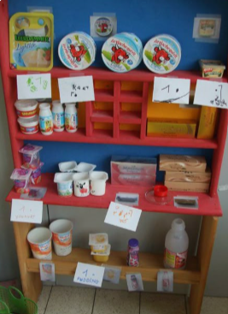
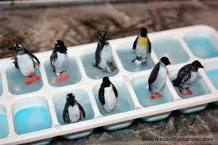
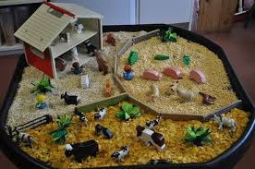
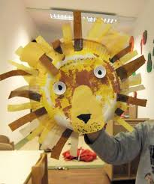
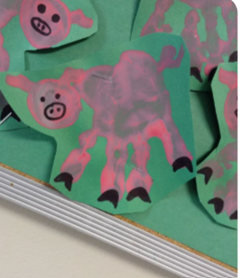
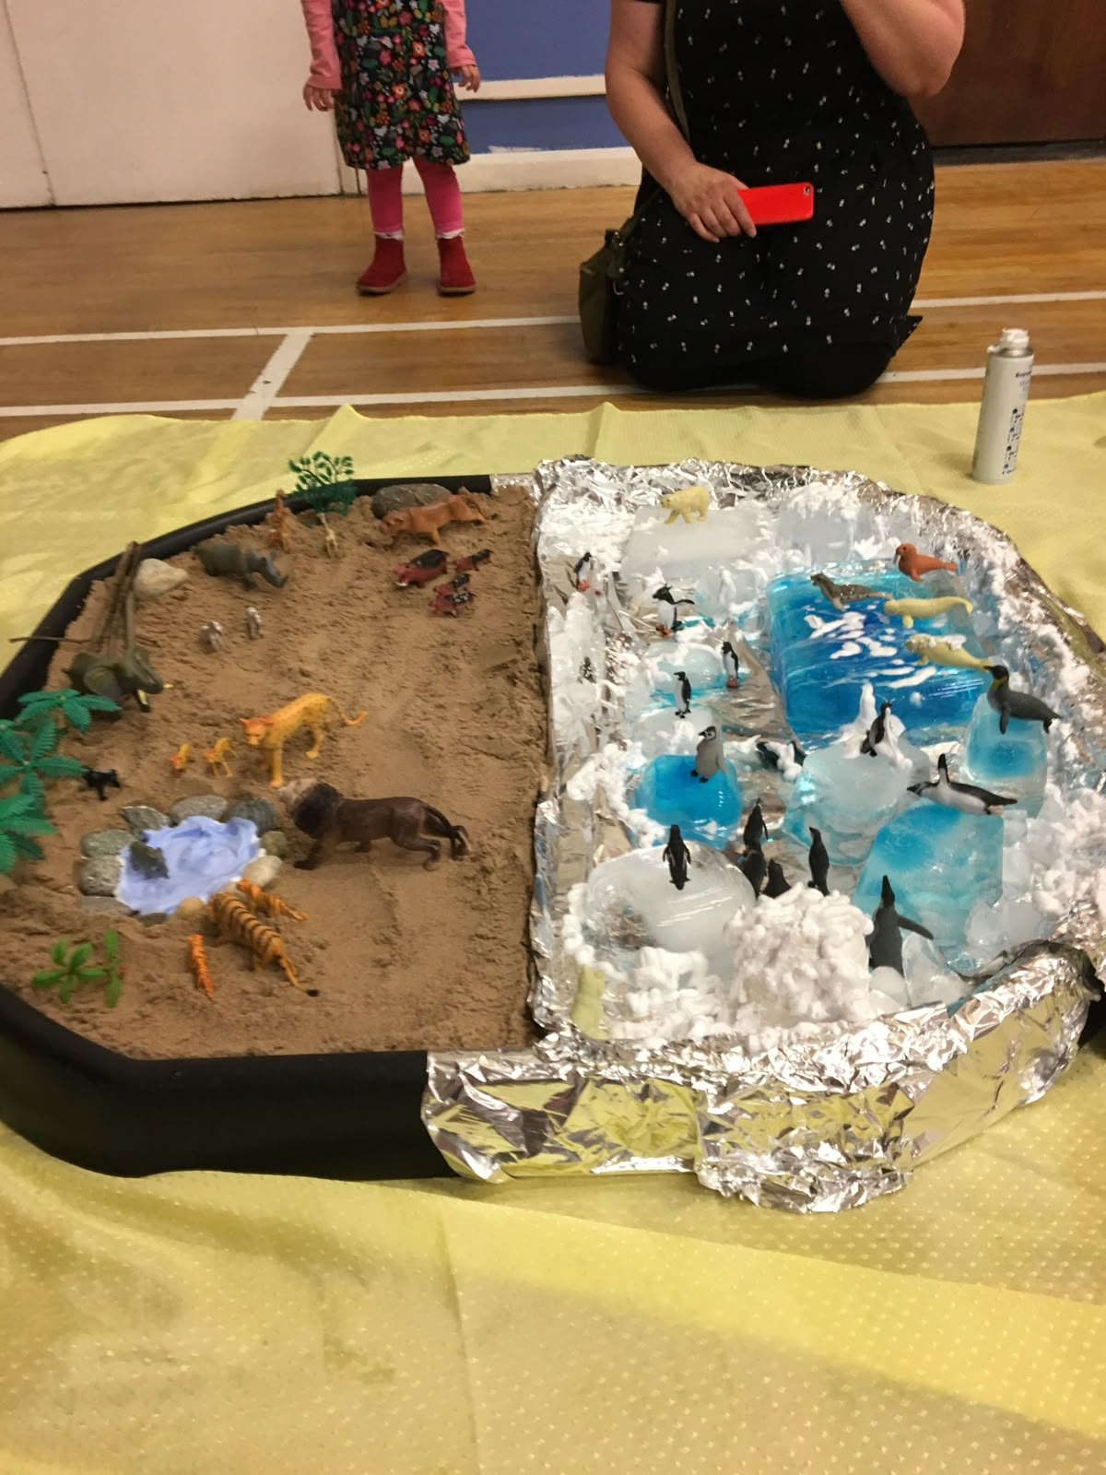
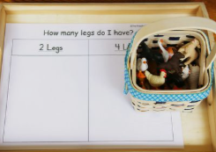
Greenfields Community School– Knowledge Organiser
Understanding the World | The World Focus | Reception | Spring 1
Five Fabulous Facts
I know I learn by what I see, touch, hear, taste and smell
I know I live in the Meadows in Great Britain
I can name and describe animals that live on farms in Britain and can talk about products we get from animals
I know there are other countries in the world and can name animals that live in hot countries and cold countries.
I can talk about some similarities and differences between different animals and different places in the world
Examples of work
Key Vocabulary
touch, taste, see, hear, smell, same, different, hot, cold, Arctic, Antarctic, Savanna, Great Britain

