Slide 1

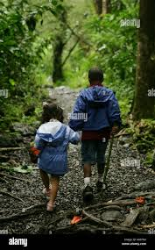
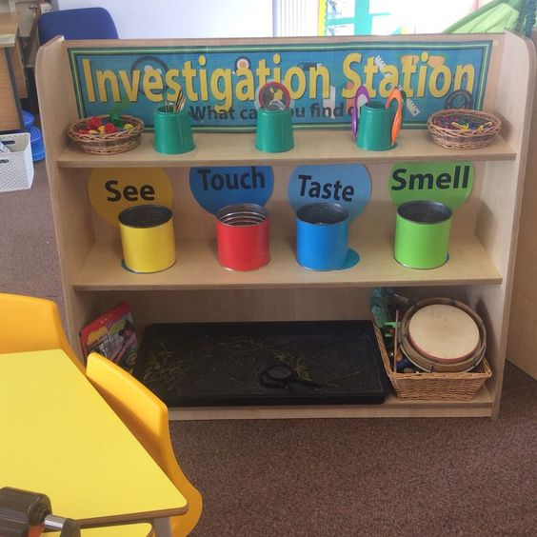
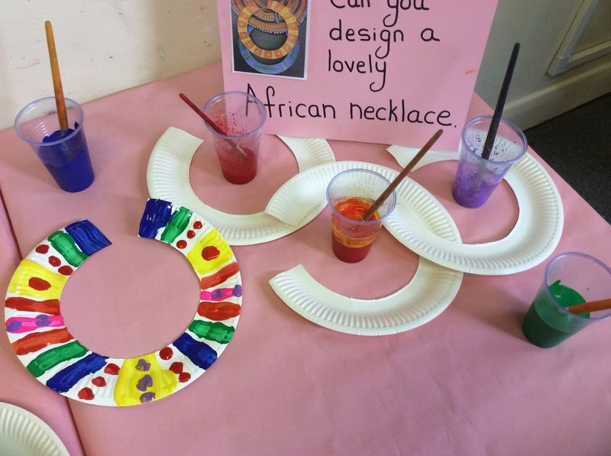
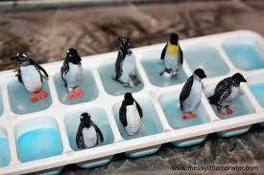
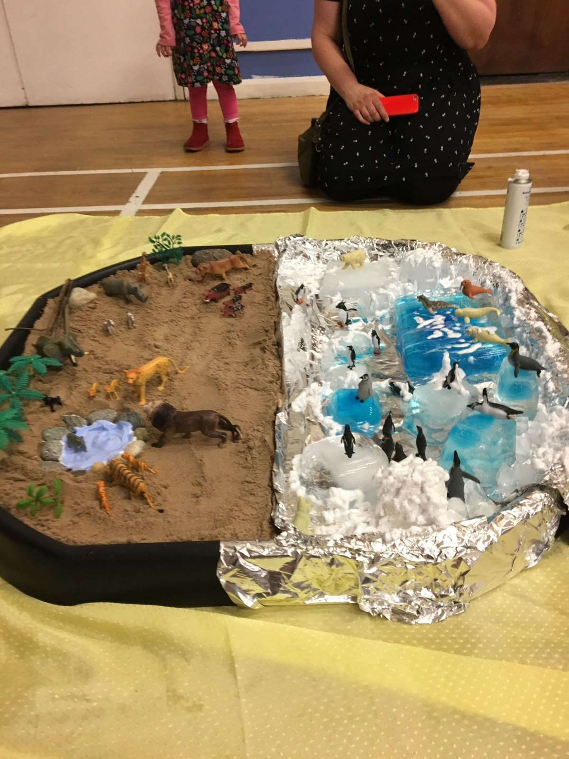
Greenfields Community School– Knowledge Organiser
Understanding the World | The World Focus | Nursery | Spring 1
Five Fabulous Facts
I know I learn by what I see, touch, taste, smell, hear
I know where I live
I know there are other countries in the world
I know what animals live in cold countries
I know what animals live in hot countries
Examples of work
Key Vocabulary
Touch, Taste, See, Hear, Smell, same, different, hot, cold

