Slide 1

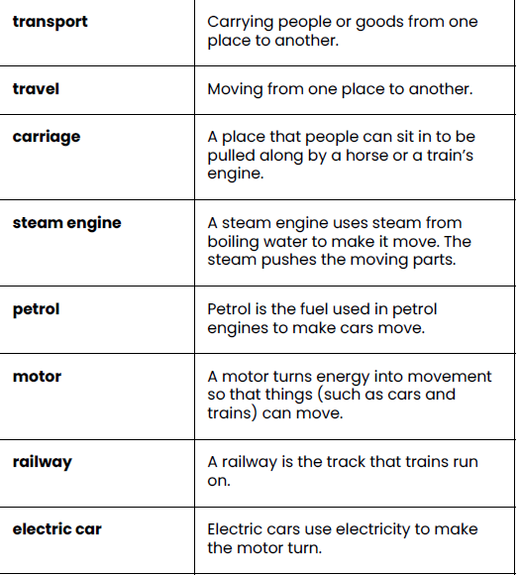
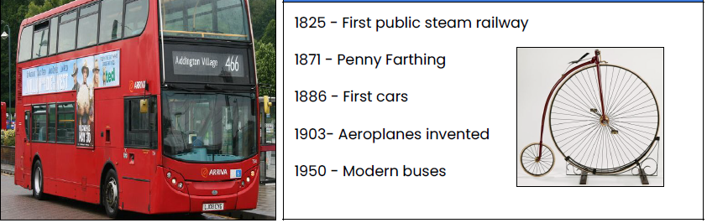
Greenfields Community School– Knowledge Organiser
History Focus | I wonder how transport has changed over time? | Year 2 | Autumn 1
Key Vocabulary
Fabulous Facts
The first aeroplane flight was made by the Wright Brothers in 1903. The first motor car was invented in 1885 by Karl Benz . George and Robert Stephenson invented the first steam locomotive called the Blucher and changed Britain forever. in the past the Great Central Railway passed through the Meadows

