Slide 1

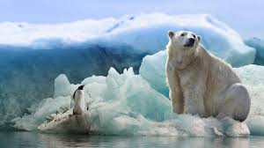
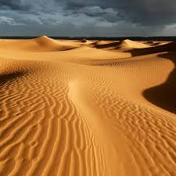
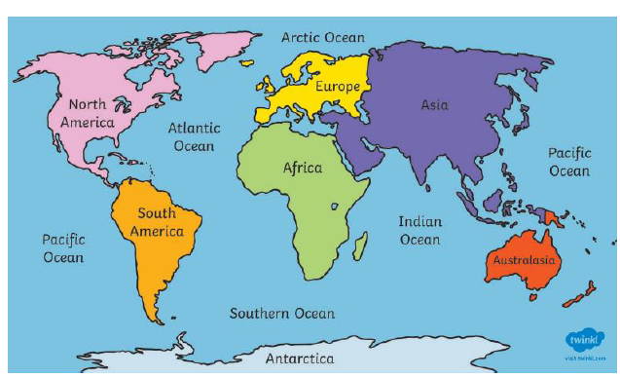
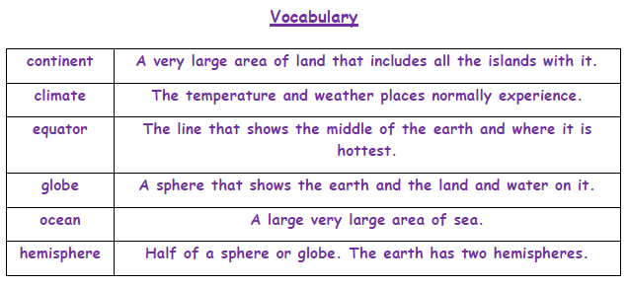
Greenfields Community School– Knowledge Organiser
Geography | Hot and cold places | Year 2 | Autumn 2
Fabulous Facts
I wonder what the hottest and coldest places on earth are like? I know that we live on the planet Earth and it is spherical. I know there are 7 continents Asia, Africa, North America, South America, Antarctica, Europe, Australia. I know there are 5 Oceans, Pacific, Indian, southern, Artic, Atlantic. I know there are hot and cold deserts. A desert is a place where there is very little rain. I Know that rainforests are found along the equator.

