Slide 1

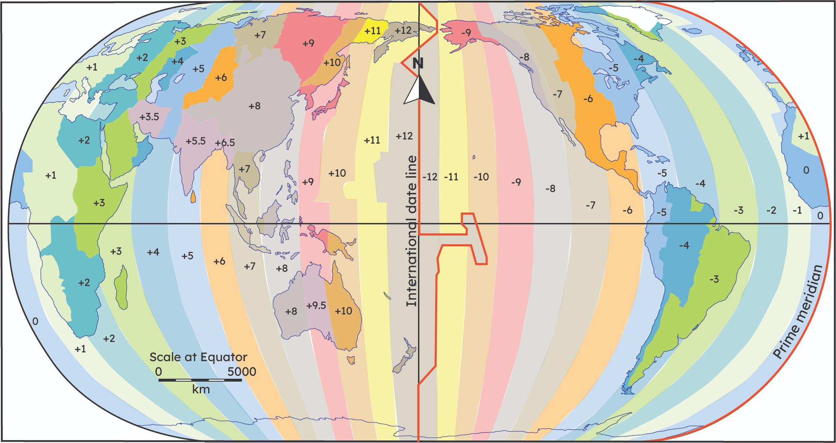
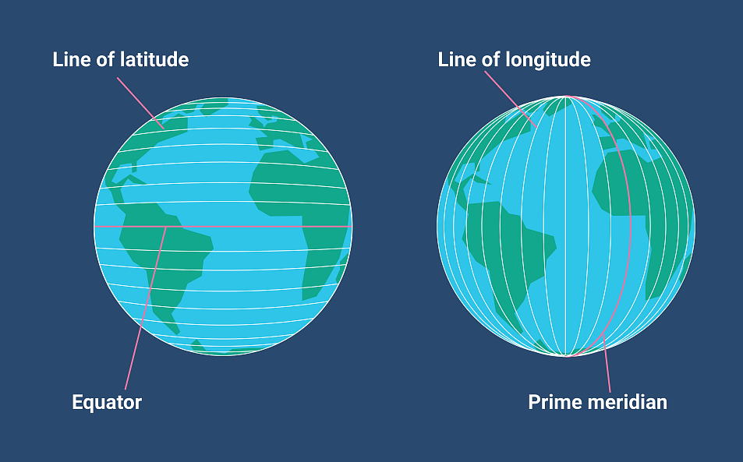
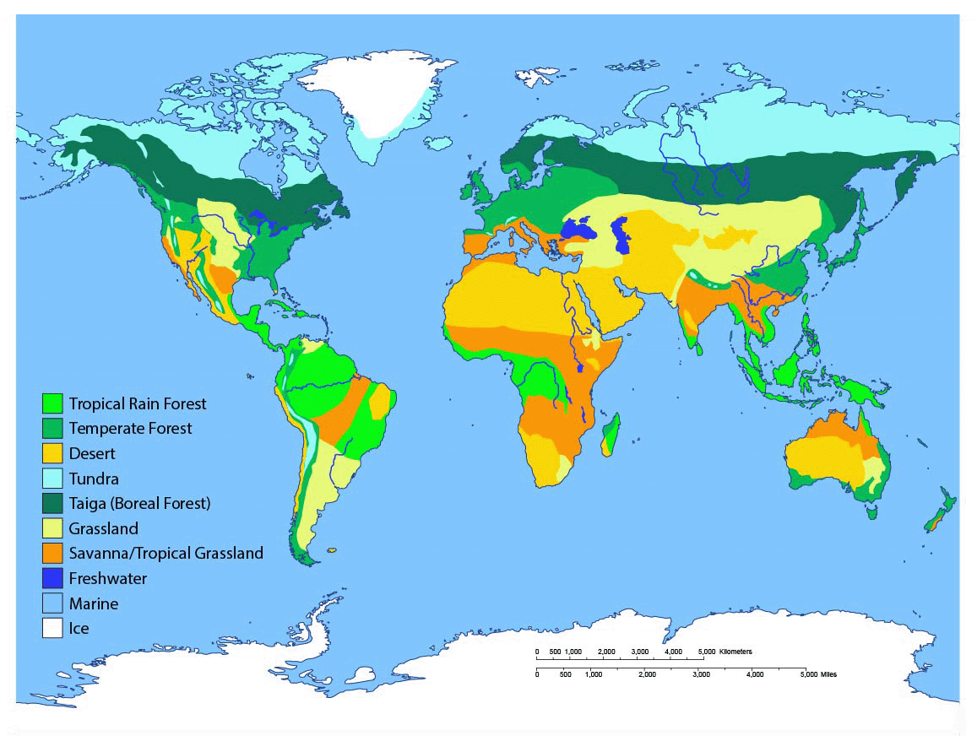
Greenfields Community School– Knowledge Organiser
Geography | I wonder why our planet is so varied | Year 5 | Autumn 2
Five Fabulous Facts about Planet Earth.
I know the equator is an invisible line around the globe which separates the Northern and Southern Hemisphere
I know the distance from the equator affects the climate (how hot or cold).
I know a biome is determined by what lives and grow in an environment as well as the climate.
I know there are 24 time zones.
I know the International Date Line marks the boundary between one day and the next.
Time Zones
Vocabulary
Equator – an invisible line around the globe Climate – how hot or cold it is on average Biome – a large region with a specific climate, certain plants and animals Prime Meridian – imaginary line which separate the Eastern and Western Hemispheres
Lines of Latitude and Longitude
Biomes

