Slide 1

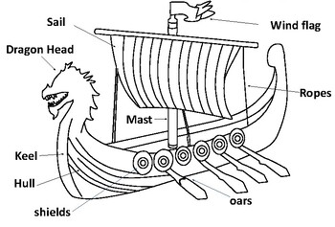
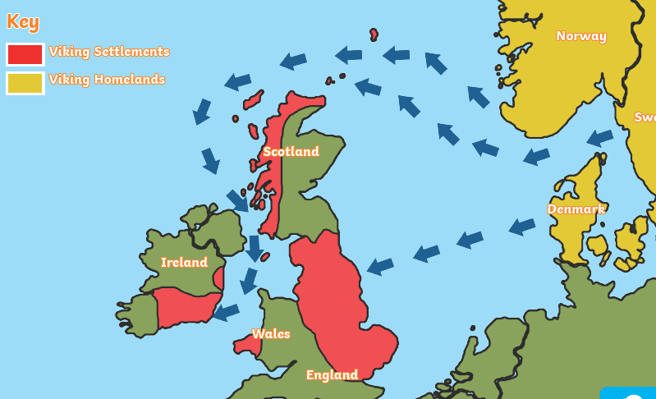
Greenfields Community School– Knowledge Organiser
History | I wonder how we should remember the Vikings. | Year 5 | Autumn 1
Five Fabulous Facts about the Vikings.
I know the Vikings were in Britain alongside the Anglo Saxons from 793AD to 1066AD. I know there were similarities and differences between the Vikings and Anglo Saxons.
I know the Vikings were first raiders, then invaders, the settlers.
I know the Vikings came to Britain from Scandinavia and settled in parts of Ireland, Scotland and the Midlands/East Anglia in England. I know they travelled by longboat.
I know the Vikings came to Nottingham and in 867AD built a fort there.
I know parts of English were under Danish laws – this was called Danelaw.
Parts of a Viking longship
Vocabulary
Danegald – a land tax Danelaw – parts of Britain which were under Danish law Longship – a narrow boat used by Vikings Raid – a surprise attack Hoard – to keep hold and stock valuable objects Christianity – a religion with one God Pagan – a religion with many Gods
Routes the Vikings travelled

