Slide 1

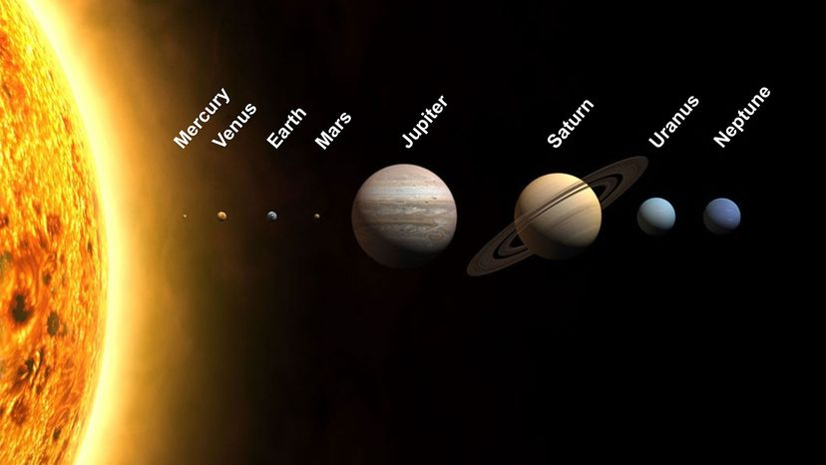
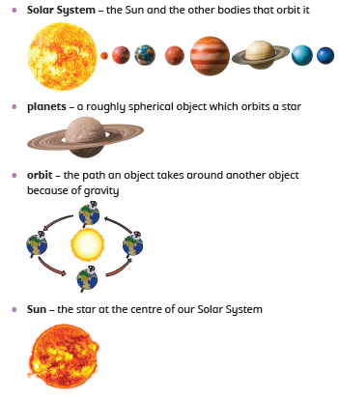
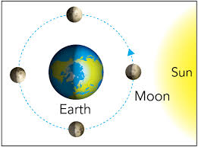
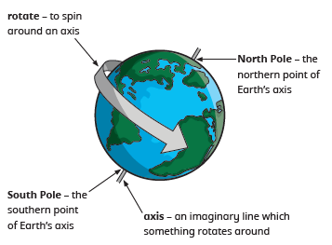
Greenfields Community School– Knowledge Organiser
Science | Physics: Space | Year 5 | Autumn 1
Five Fabulous Facts about space.
I know there are eight planets in the solar system (Mercury, Venus, Earth, Mars, Jupiter, Saturn, Neptune)
I know planets orbit the Sun.
I know the Sun is a star.
I know the Earth rotates on its axis which gives us night and day. I know the Earth’s axis is tilted, which gives us seasons.
I know the Moon orbits the Earth.
The Solar System
Vocabulary
The Sun, the Earth and the Moon

