Slide 1

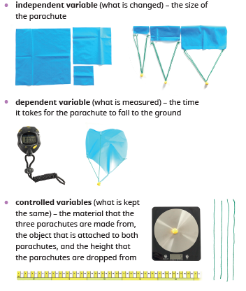
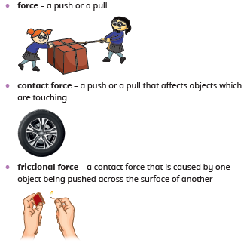
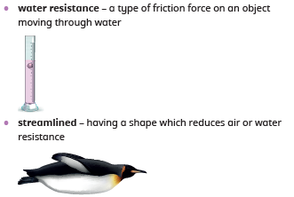
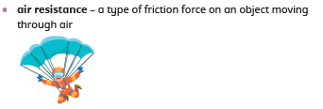

Greenfields Community School– Knowledge Organiser
Science | Physics: Forces | Year 5 | Autumn 1
Five Fabulous Facts about forces.
I know a force is a push or a pull and that a contact forces affects objects that are touching.
I know friction is a contact force that is caused by one object being pushed across the surface of another. Fiction can slow down or stop a moving object. Smoother objects have less friction.
I know water resistance is a type of friction force that affects objects moving through water. I know streamlined objects have less water resistance.
I know air resistance is a type of frictional force that affects objects moving through air. The greater the surface area of an object, the greater the air resistance.
I know gravity is a non-contact force that causes objects to fall towards the ground.
Variables
Vocabulary

