Slide 1

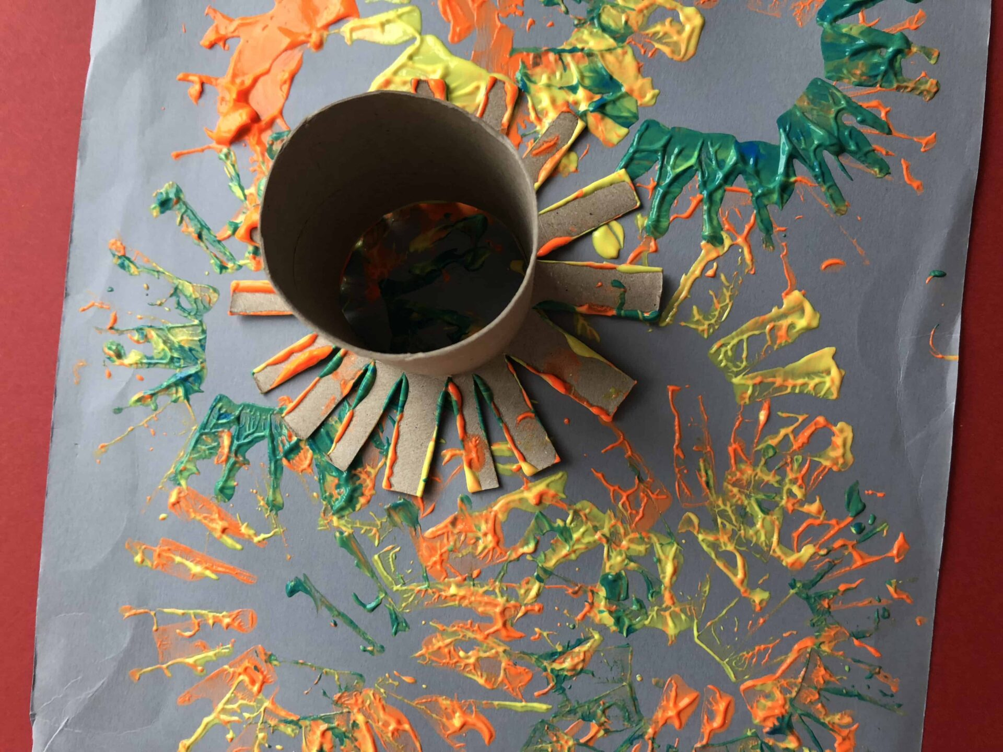
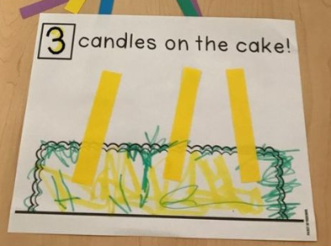
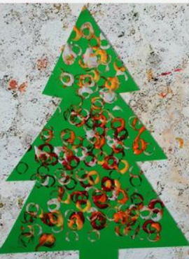
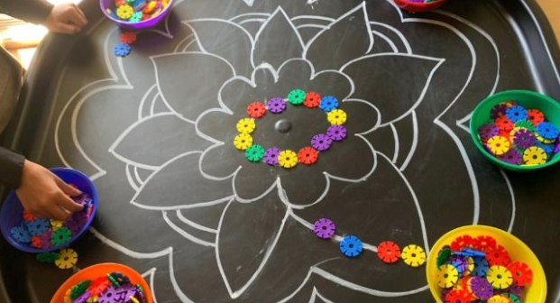
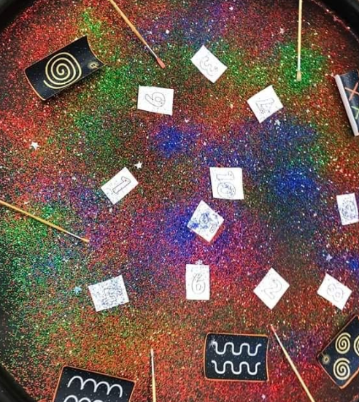
Greenfields Community School– Knowledge Organiser
Understanding the world | People, Culture and Communities | Reception | Autumn 2
Five Fabulous Facts
I know how to stay safe near fireworks
I know what I celebrate in my family
I know how I celebrate special times in my family
I know some people celebrate different festivals
I know the names of 3 different celebrations
Examples of work
Key Vocabulary
safe, bonfire, celebrate, celebration, festival, birthday, Diwali, Christmas

