Slide 1

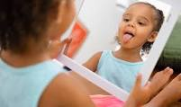
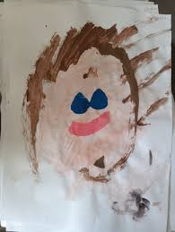
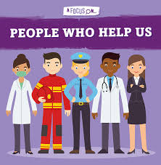
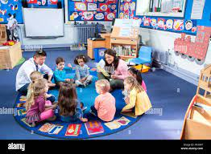
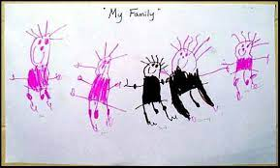
Greenfields Community School– Knowledge Organiser
Personal Social & Emotional Development | Building relationships | Nursery | Autumn 1
Five Fabulous Facts
I know my class is Nursery
I know My teachers are Mrs Thomas and Mrs Fletcher
I know who is in my family
I know what makes me happy
I know people who can help me
Examples of work
Key Vocabulary
Nursery, Mummy, Daddy, family, teachers, happy and sad

